Slide 1
Smart In-situ Visualization for Large-scale Numerical Simulations Aiming at Efficient Knowledge Acquisition
Naohisa Sakamoto naohisa.sakamoto@people.kobe-u.ac.jp
Kobe University / RIKEN R-CCS Kobe, Japan
The 4th China-Japan Joint Visualization Workshop July 24, Wuhan, China (Online)
Notes:
I'm Naohisa Sakamoto from Kobe University, Japan. Today, I'm going to talk about smart in-situ visualization for large-scale numerical simulations aiming at efficient knowledge acquisition. Currently, I'm also a visiting researcher at RIKEN center for computational science. And this work has been done in collaboration with researchers and engineers in RIKEN R-CCS.

Slide 2
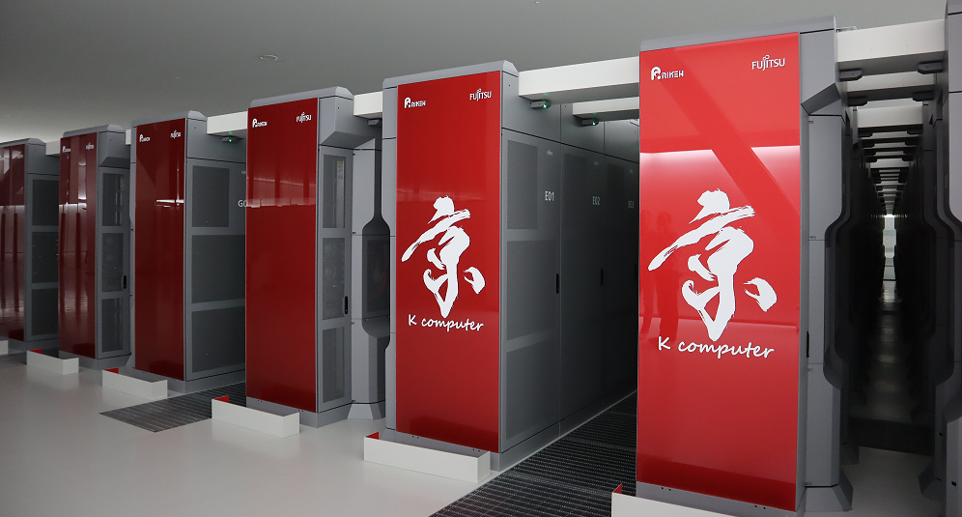
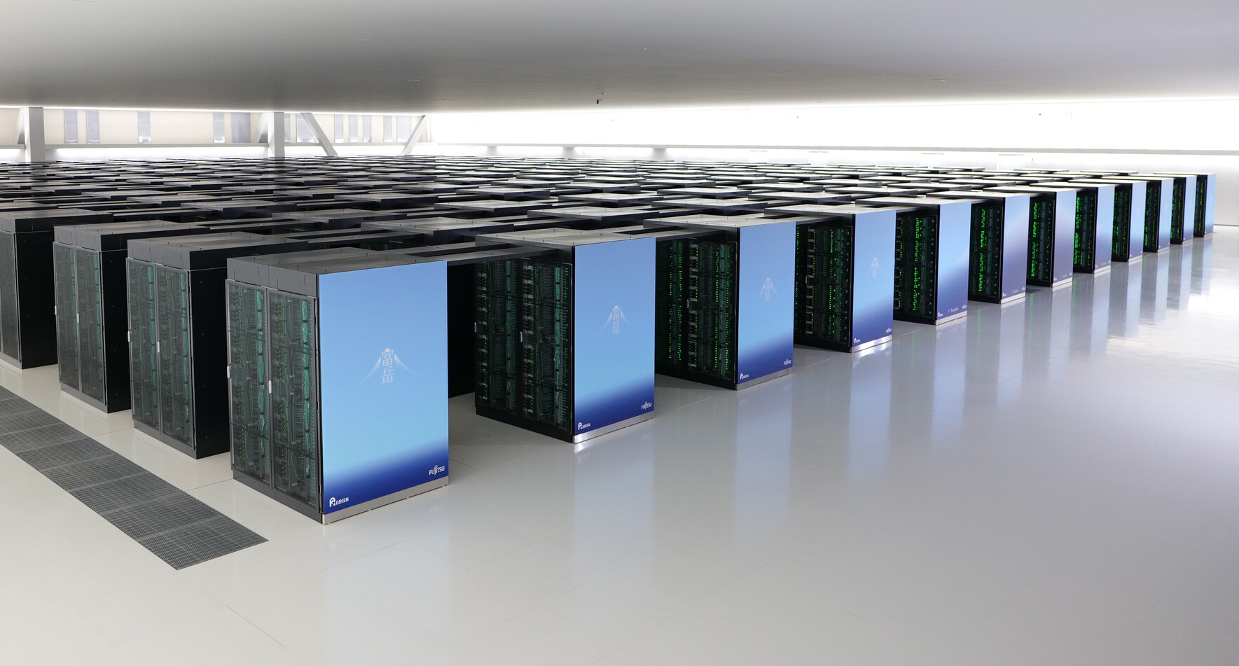
High Performance Computing Systems
Supercomputer Fugaku
158,976 processing nodes
537 PFLOPS
Awarded
Top500, HPCS, HPL-AI, Graph500
K computer (SPARK64)
Sep.2012 to Aug.2019
Visualization and analysis tasks even more challenging
Fugaku (ARM-based A64FX)
Mar.2020 - present
Notes:
At the RIKEN Center for Computational Science, the K computer was decommissioned in August 2019 after several years of continuous service operation, and the Fugaku supercomputer began to be used for shared use in March 2020. The fugaku system is consist of more than 150,000 processing nodes and its peak performance ins 537 PetaFLOPS. And it was awarded first place on the TOP500 list—the best known supercomputing benchmark, as well as HPCG, a measure of supercomputer performance on real-world applications, and HPL-AI, which ranks computers on artificial intelligence related tasks, and Graph500, which gauges a computer’s ability to handle data-intensive loads.

Slide 3
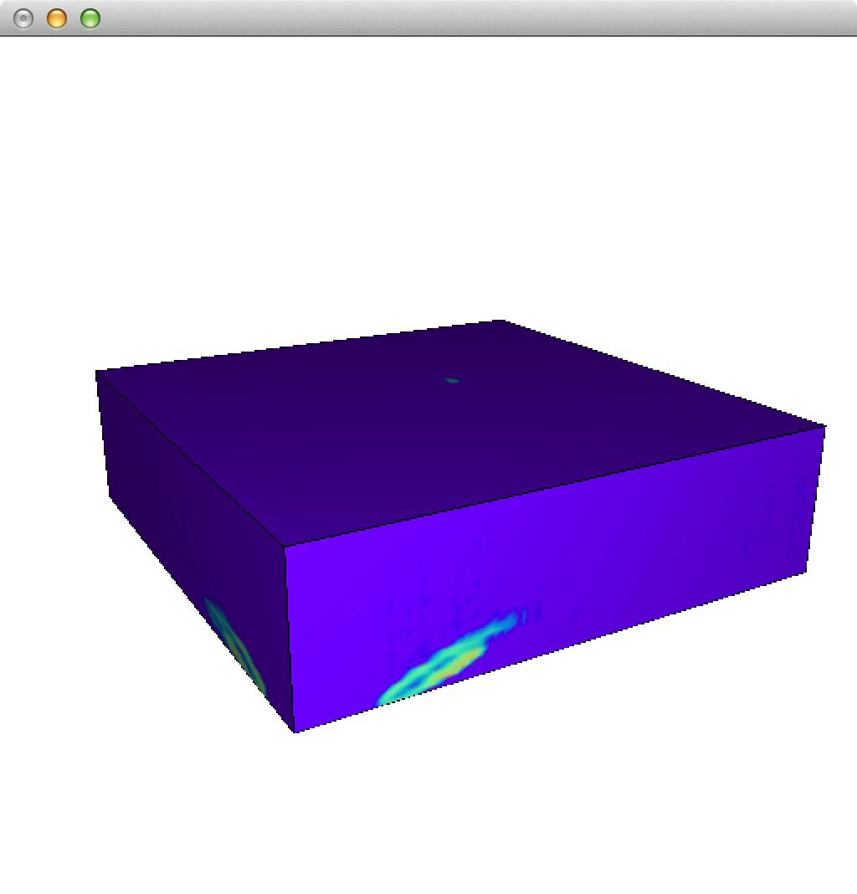
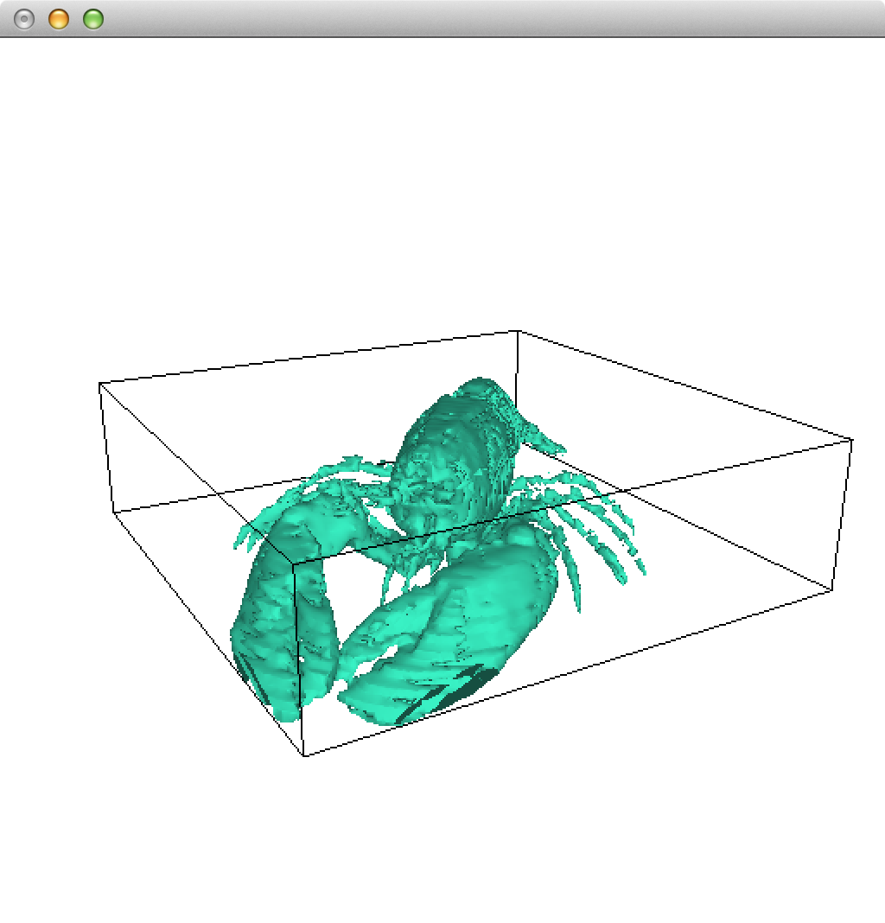
In-situ Visualization
Post-hoc
In-situ
Simulation
Data I/O
Filtering/Mapping
Analysis
Rendering
Display
Exploring
Simulation
Filtering/Mapping
Analysis
Rendering
Display
Exploring

Slide 4
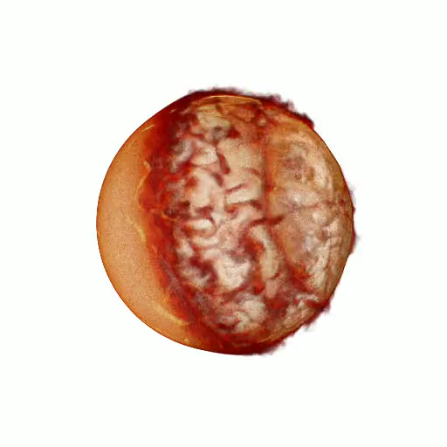
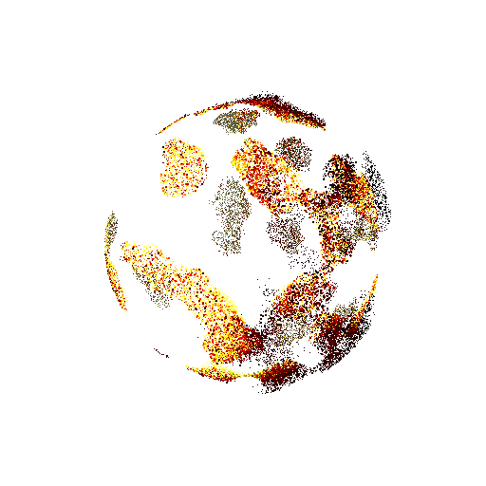
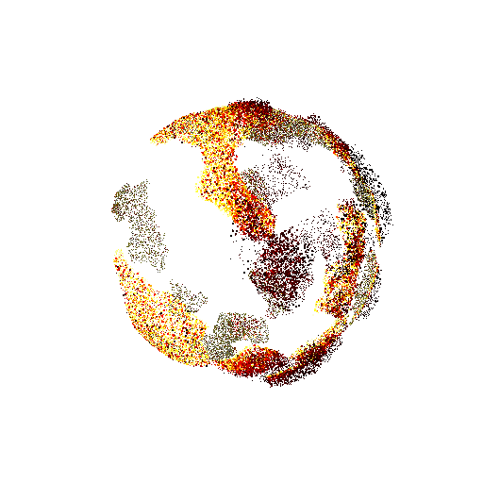
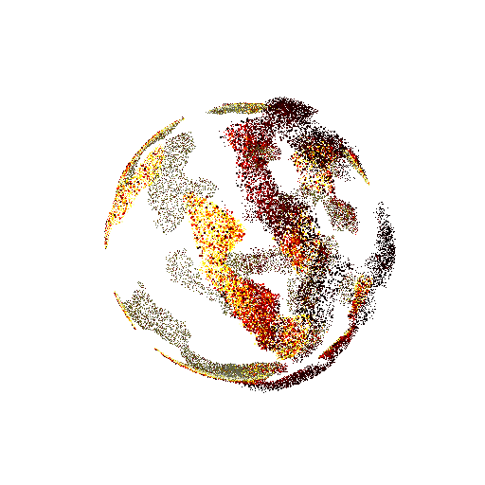
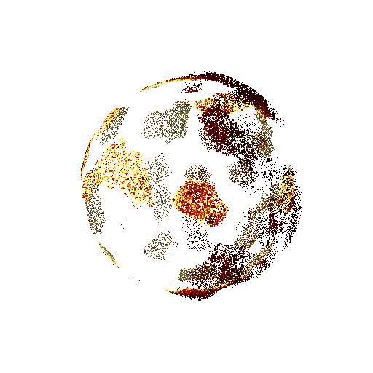
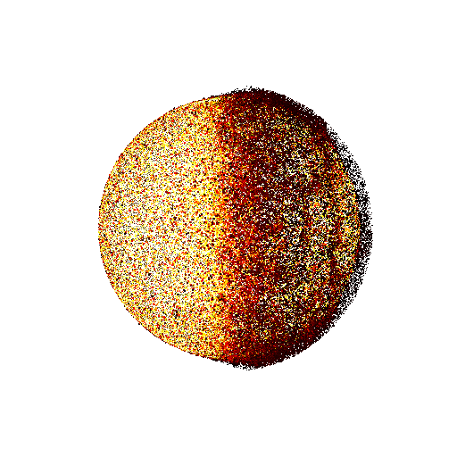
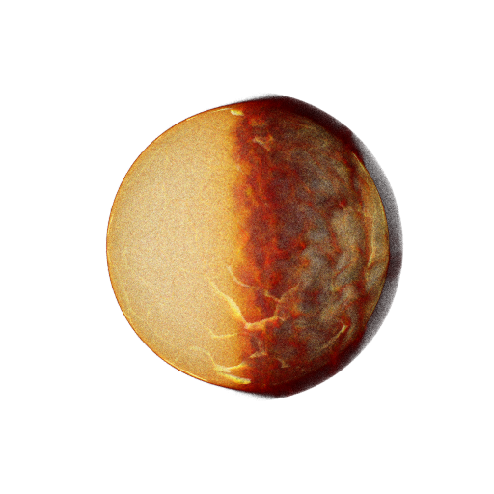
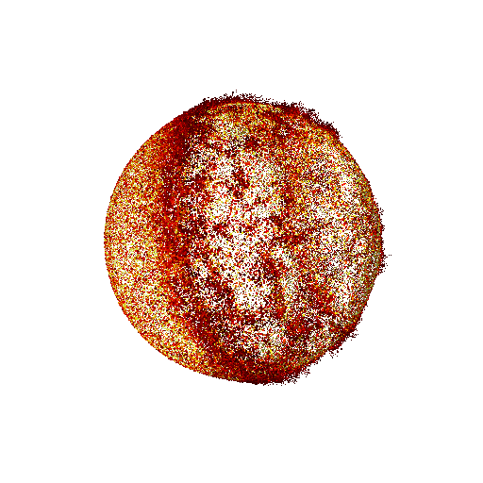
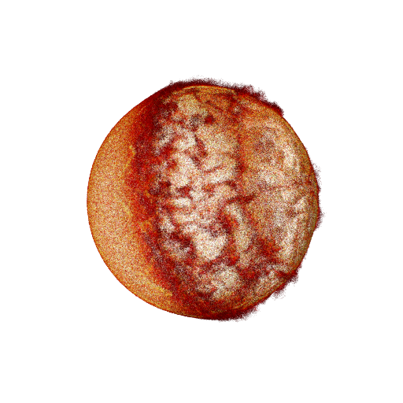
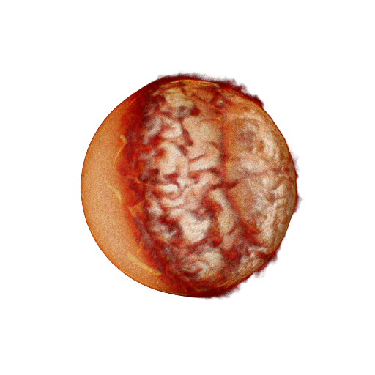
Parallel Rendering
Order-independent technique for volume rendering
Sub Vol 1
Sub Vol 2
Sub Vol 3
Sub Vol m
Final Image
Ensemble
Image 1
…
CFD simulation: Magnus force acting on a rotation ball placed in a uniform flow
19M prism elements
256 sub-volumes
Ensemble
Image 2
…
…
…
…
…
…
…
…
Ensemble Averaging
w/o ordering
Ensemble
Image n
…
1
10
100
Stochastic Rendering
w/o ordering
Image Composition w/o ordering
# of ensemble images
Y. Yamaoka, K. Hayashi, N. Sakamoto, J. Nonaka, A Memory Efficient Image Composition-based Parallel Particle Based Volume Rendering, JASSE, Vol.6, Issue.1, pp.1-10, 2019.3

Slide 5
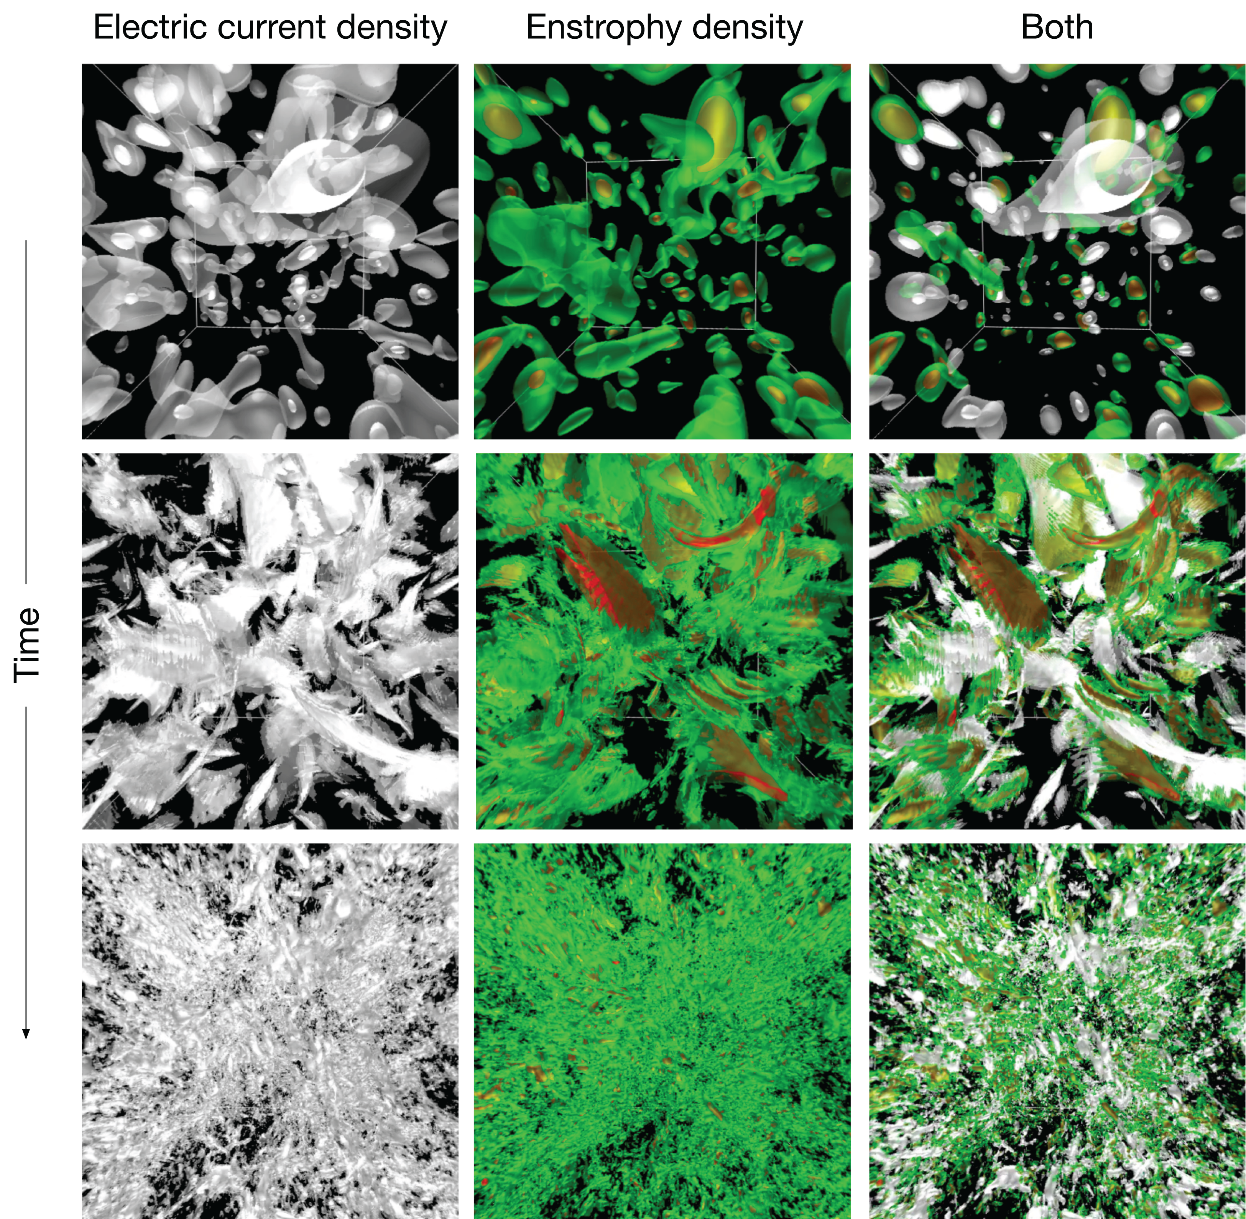
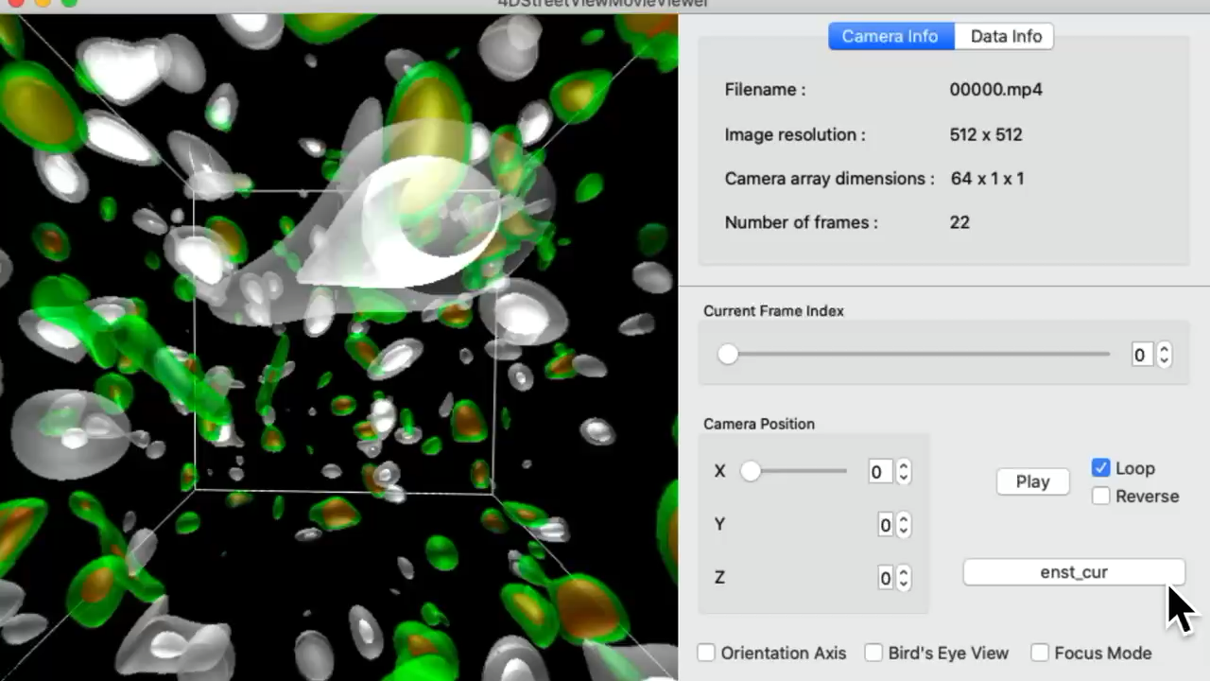
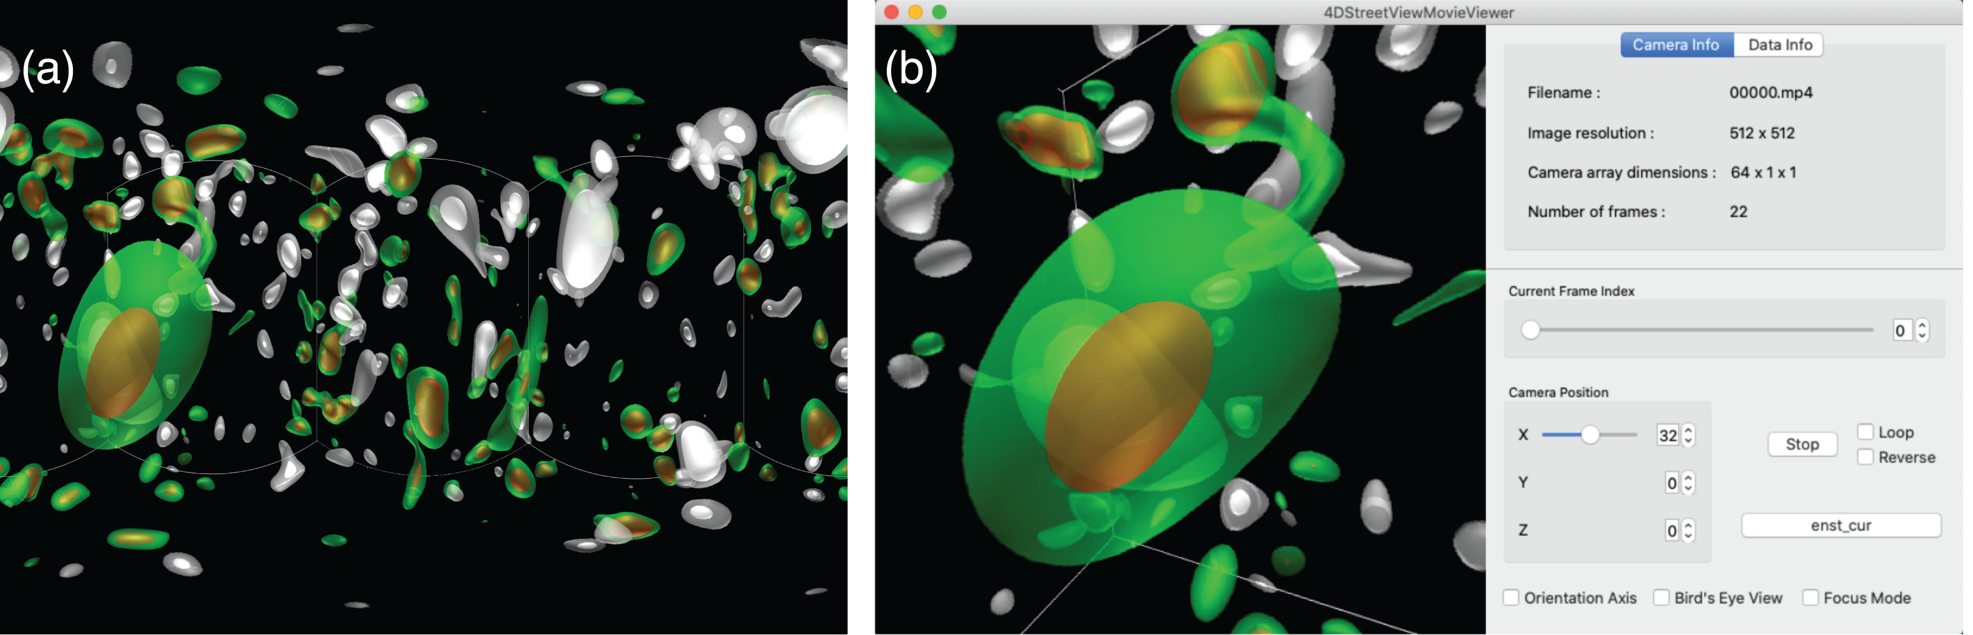
Interactive Exploration for In-situ Vis.
Multi-viewpoint omni-directional rendering
Omni-directional movie
Post-hoc data exploration for in-situ visualization results based on mutli-viewpoint omnidirectional movies.
Gnomonic Projection
In-situ visualization of the hall HMD simulations: Semi-transparent isosurfaces for two different physical quantities.
Akira Kageyama, Naohisa Sakamoto, 4D Street View: A Video-based Visualization Method, PeerJ Computer Science, 6:e305, DOI:10.7717/peerj-cs.305, 2020.9.

Slide 6
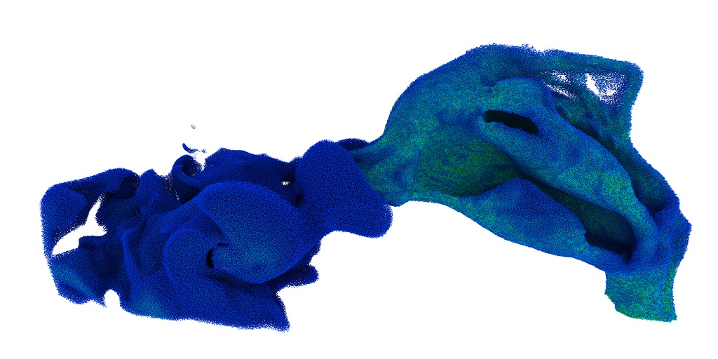
In-situ Visualization on HPC Environment
Blind execution
Pre-defined visualization parameters
File staging based processing
Rendering for time-varying datasets
Large number of output images
😩

Slide 7
Smart In-situ Visualization
Time to discover
In-situ timestep selection
😄
Important images
Japan Society for the Promotion of Science (JSPS), Grant-in-Aid for Scientific Research (B) 20H04194, Smart in-situ visualization for large-scale numerical simulations aiming at efficient knowledge acquisition
Notes:
We especially deserved our attention to the “Smart In-Situ Processing” focusing not only on the rendering performance, but to reduce the “time-to-discovery”, for instance, by eliminating unnecessary rendering or image generation by adaptively selecting the most important time-steps.
Our plan is to continuously aggregate new functionalities to assist the visual analysis by reducing the time-to-discovery, by easily gaining insight into the data, and facilitate its understanding.

Slide 8
In-situ Timestep Selection
Based on the amount of changes between the simulation timesteps
Easy to find the important features related to the correct understanding of the underlying physical phenomena
Helpful for the data I/O and visualization cost savings
Y. Yamaoka, K. Hayashi, N. Sakamoto, J. Nonaka, In-Situ Adaptive Timestep Control and Visualization based on the Spatio-Temporal Variations of the Simulation Results, ISAV2019, pp.12-16, 2019.11

Slide 9
In-situ Timestep Selection
Adaptive timestep selection for in-situ visualization
Simulation
Visualization
V₀
V₁
V₂
‥ ‥
V_{t-1}
V_{t}
V_{t+1}
‥ ‥
V₀
V₁
V₂
‥ ‥
V_{t-1}
V_{t}
V_{t+1}
‥ ‥

Slide 10
In-situ Timestep Selection
Spatio-temporal variations between volumes
Adaptive timestep sampling
…
V_{t-1}
V_{t}
…
Variations
Not important
Important
Timestep
: Vis.
: Not vis.
Time

Slide 11
Spatio-temporal Variations
Time-varying volume dataset
V_{t}^{m-1}
‥‥
V_{t}^{m}
V_{t}¹
V_{t}²
‥‥
V_{t}^{m+1}
V_{t} = {V_{t}¹,V_{t}², … , V_{t}^{m}, …, V_{t}^{M}}
V₀
V₁
‥ ‥
V_{t}
‥ ‥
Time
0
1
t

Slide 12
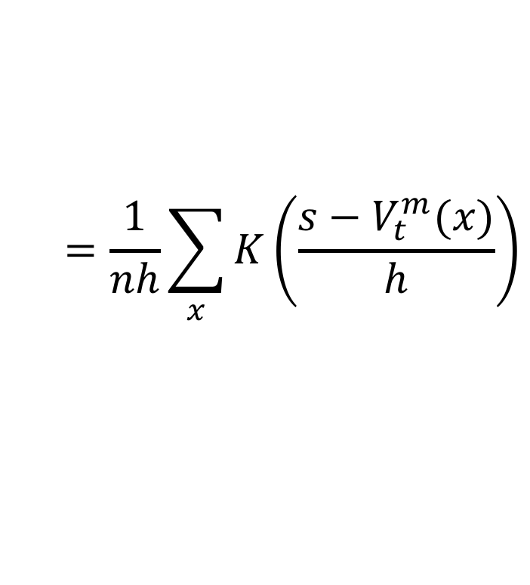
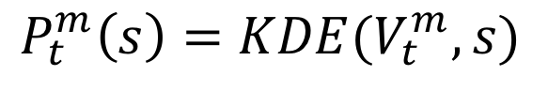
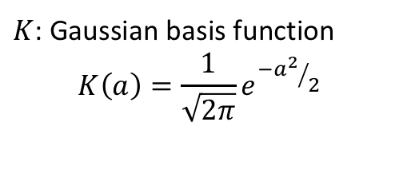
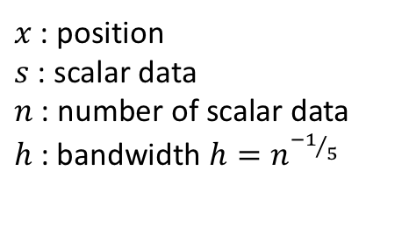
Spatio-temporal Variations
Probability density function P of each sub-volume
Kernel Density Estimation (KDE)
P
P_{t}^{m}
$$P_{t}^{m}\left(s\right)=KDE(V_{t}^{m},s)$$
‥‥
$$=\frac{1}{nh}\sum_{x}{K\left(\frac{s−V_{t}^{m}(x)}{h}\right)}$$
S
V_{t}^{m-1}
$x$: position
$s$: scalar data
$n$: number of scalar data
$h$: bandwidth $h=n^{{−1}/5}$
$K$: Gaussian basis function $$K\left(a\right)=\frac{1}{\sqrt{2π}}e^{{−a^{2}}/2}$$
‥‥
V_{t}^{m}
V_{t}¹
V_{t}²
‥‥
V_{t}^{m+1}

Slide 13
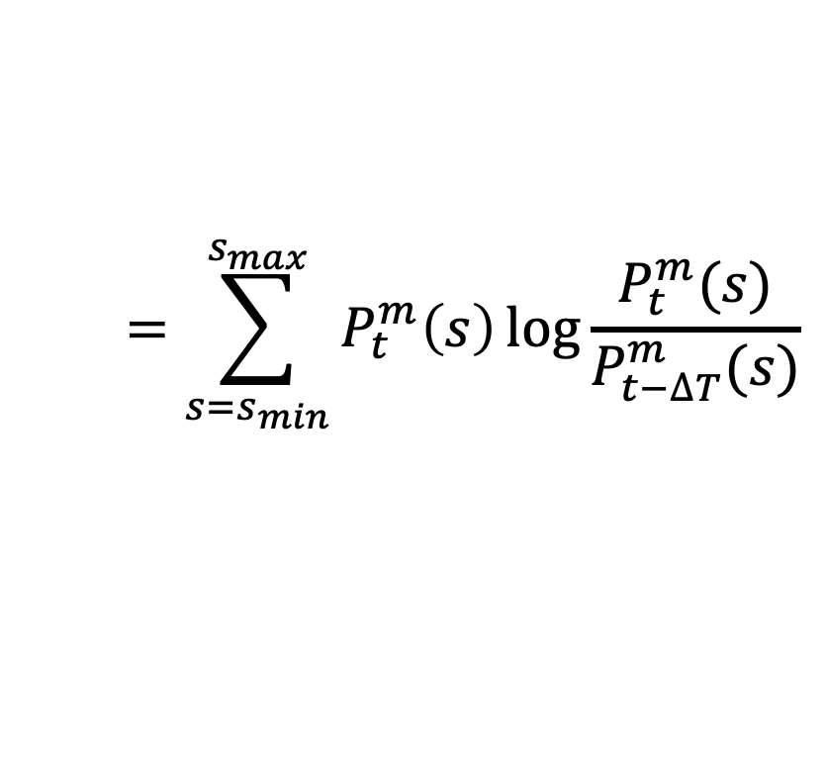
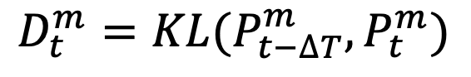
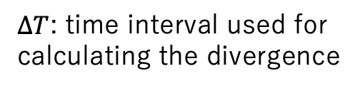
Spatio-temporal Variations
Relative divergence D between PDFs
Kullback-Leibler (KL) divergence
D_{t}^{m}
^{m}
P_{t-ΔT}
P_{t}^{m}
$$D_{t}^{m}=KL(P_{t−∆T}^{m},P_{t}^{m})$$
$$=\sum_{s=s_{min}}^{s_{max}}{P_{t}^{m}\left(s\right)\log{\frac{P_{t}^{m}(s)}{P_{t−∆T}^{m}(s)}}}$$
‥‥
‥‥
V_{t-ΔT}
V_{t}
$∆T$: time interval used for calculating the divergence
Time
t-ΔT
t

Slide 14
Spatio-temporal Variations
Relative divergence D between PDFs
Kullback-Leibler (KL) divergence
D_{t}^{m-1}
‥‥
D_{t}^{m}
D_{t}¹
D_{t}²
‥‥
D_{t}^{m+1}
D
D_{t} = max(D_{t}¹, D_{t}², … , D_{t}^{m}, …, D_{t}^{M})
Time
t - ΔT
t

Slide 15
Adaptive Time Sampling
Variation patterns
D
A
B
C
A
D_{THR}
Time
T_{p-1}
T_{p}
T_{p+1}
Δt
Δt’
ΔT
t₀
t₁
t₂
‥‥
‥‥
t’_{k-1}
t’_{k}
t’_{k+1}
‥‥

Slide 16
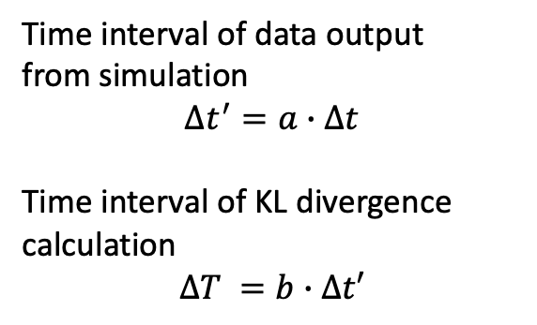
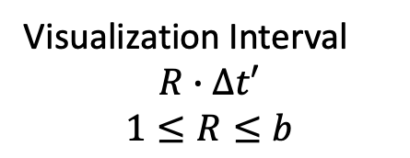
Visualization Interval
Granularity R for low variation region
T_{p-1}
T_{p}
Time interval of data output
from simulation
$$∆t^{′}=a∙∆t$$
Time interval of KL divergence calculation
$$∆T =b∙∆t′$$
Time
Δt
Δt’
ΔT
Stacking
Fine
R = 1
Rendering
Visualization Interval
$$R∙∆t′$$
$$1≤R≤b$$
R = 2
R = 4
Coarse

Slide 17
Visualization Interval
Granularity for each pattern
Pattern A
Coarse sampling
Using specified R
Pattern B
Fine sampling
Using R = 1
Pattern C
Combined sampling
Using R = 1 (fine) in the first half and specified R in the other half
A
B
C
Coarse
(Specified R)
Fine
(R = 1)
Fine
(R = 1)
Coarse
(Specified R)

Slide 18
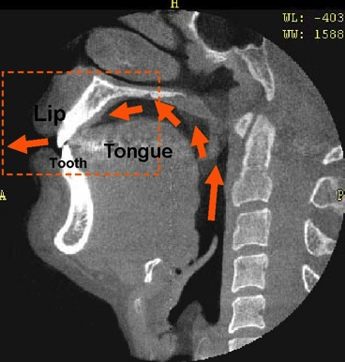
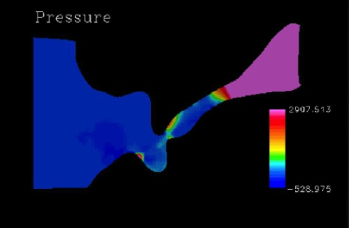
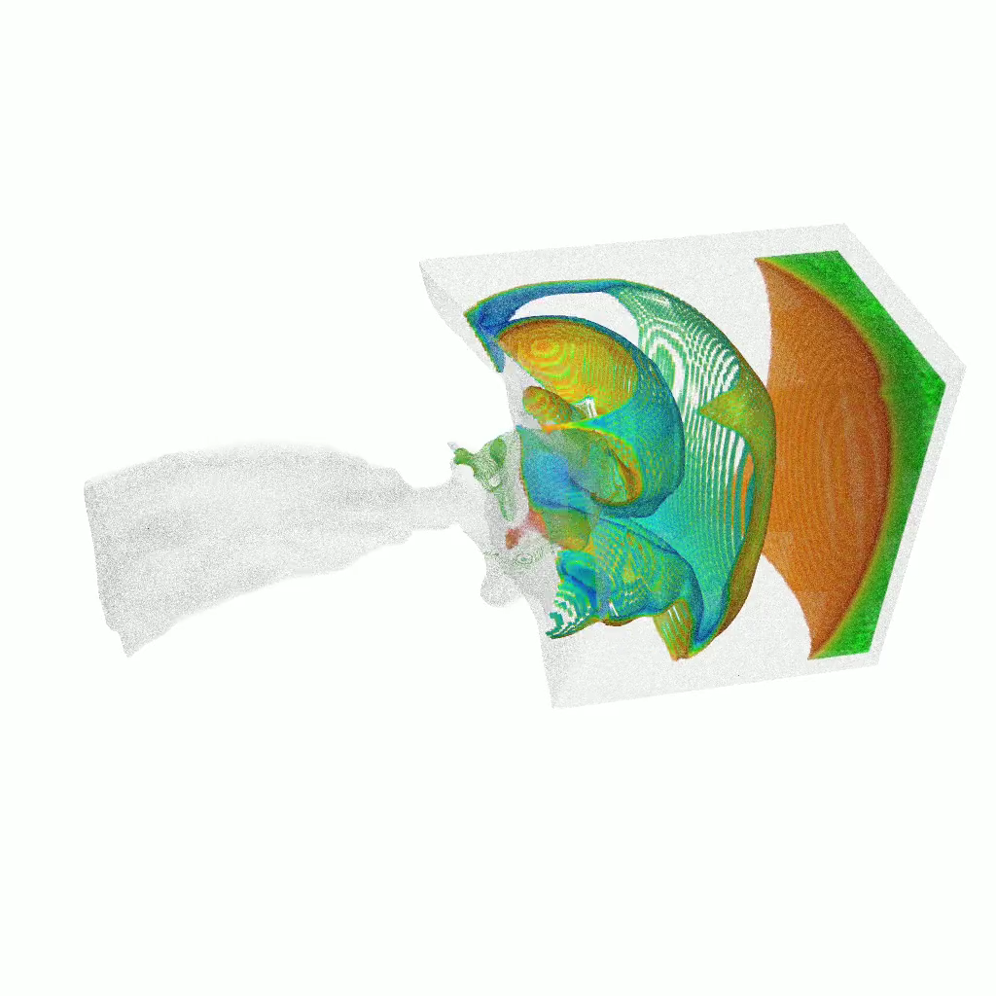
Experiment
Numerical simulation of sibilant fricatives
Implicit compressible flow solver based on OpenFOAM
Unstructured volumes
3,197,279 hexahedrons
48 subvolumes
20,000 timesteps

Slide 19
Experiment
Environment
K pre-post cloud system
X86 based on-premise could system
Dual Intel Xeon Platinum 8168 (Skylake) 24cores/2.7GHz
48 vCPUs on the VM for the evaluation
Software
Simulation: OpenFOAM
Visualization: KVS + OSMesa
Rendering:
Parallel particle-based rendering
234 image composition

Slide 20
Result
Changes of KL divergence (D)
Simulation timesteps: 20,000
KL divergence calculation interval (ΔT): 100
Number of simulations (a): 5
Number of stacking data (b): 20
KL divergence
Time step

Slide 21
Result
Number of vis. images and reduction ratio
Total number of stacked data: 4,000
D_{THR} | R=5 | R=10
0 | 4,000 (0%) | 4,000 (0%)
0.01 | 3,452 (13.7%) | 3,384 (15.4%)
0.02 | 3,100 (22.5%) | 2,896 (21.6%)
0.03 | 2,856 (28.6%) | 2,616 (34.6%)
0.04 | 2,496 (37.6%) | 2,288 (42.8%)
0.05 | 2,064 (48.4%) | 1,892 (52.7%)
D_{THR}: Threshold for the KL divergence (D)
R: Granularity for the time sampling for A and C interval patterns

Slide 22
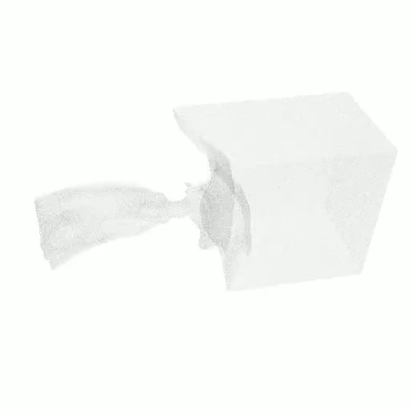
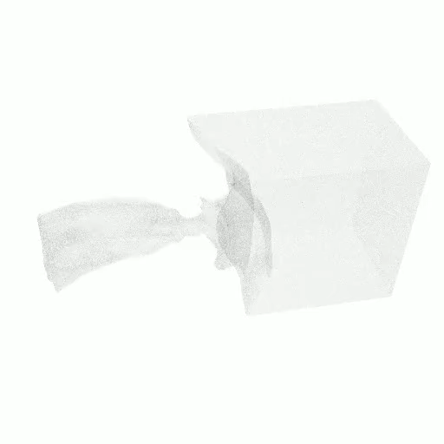
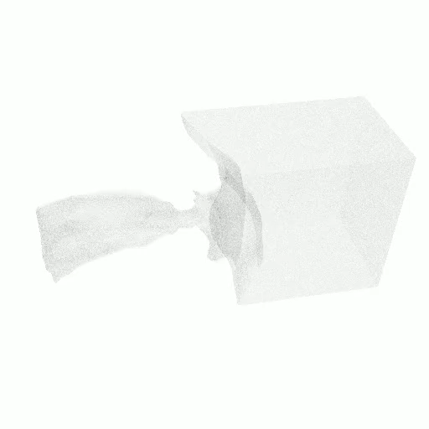
Result
In-situ visualization results with and without our method
THR = 0.005
Original
(4,000 images)
Our method with R=5
(2,064 images)
Our method with R=10
(1,892 images)

Slide 23
Conclusion
Large data visualization on HPC
Order-independent technique for parallel rendering
Multi-viewpoint omni-directional rendering for in-situ visualization
Smart In-situ visualization
Focusing on “time-to-discover” not only time-to-solution/rendering
Adaptive timestep Selection for in-situ visualization
Spatio-temporal variations between the simulation results based on the Kullback-Leibler divergence
Adaptive timestep control in consideration of the variation changing patterns
Utilizing adaptive timestep sampling mechanism for reducing the amount of data for the subsequent processing (e.g. data storing for the post-hoc visualization and analytics, in-situ/in-transit visualization)

Slide 24
Future Works
Optimal parameter selection for the input time intervals
Viewpoint selection without missing significant physical phenomenon
Feature-enhancement rendering based on ambient occlusion
Tuning and evaluation on Fugaku and other HPC systems

Slide 25
Acknowledgements
This work was partially supported by Japan Society for the Promotion of Science (JSPS), Grant-in-Aid for Scientific Research (KAKENHI)
20H04194
19H03976
Collaborators
Jorji Nonaka (RIKEN R-CCS)
Takashi Shimizu, Kengo Hayashi, Yoshiaki Yamaoka (Former Kobe U student)
Tsukasa Yoshizaki (Toyohashi University of Technology)
Kazunori Nozaki (Osaka University)

